Slide 1


Rust
CS 421: Systems Programming
Spring Semester 2021-22
Dimitris Papazachariou (dpapaz02@ucy.ac.cy)

Slide 2
History [1/2]
Rust grew out of a personal project begun in 2006 by Mozilla employee Graydon Hoare.
Mozilla began sponsoring the project in 2009 and announced it in 2010.
Rust 1.0, the first stable release, was released on May 15, 2015.
On February 8, 2021, the formation of the Rust Foundation was officially announced by its five founding companies (AWS, Huawei, Google, Microsoft, and Mozilla).
On April 6, 2021, Google announced support for Rust within Android Open Source Project as an alternative to C/C++.

Slide 3
History [2/2]
Current stable release: 1.59.0 / February 24, 2022
Platforms: AMD64, i686, arm, AArch64, armv7, mips, mips64, mipsel, mips64el, powerpc, powerpc64, powerpc64le, risc-v, s390x, WebAssembly
OS: Windows, Linux, macOS, FreeBSD, NetBSD, Illumos, Haiku, Android, Redox, iOS, Fuchsia
License: MIT or Apache 2.0

Slide 4
Rust
Rust is a systems programming language focused on three goals:
safety
speed
concurrency
systems programming language
high-level features such as functional programming
mechanisms for low-level memory management

Slide 5
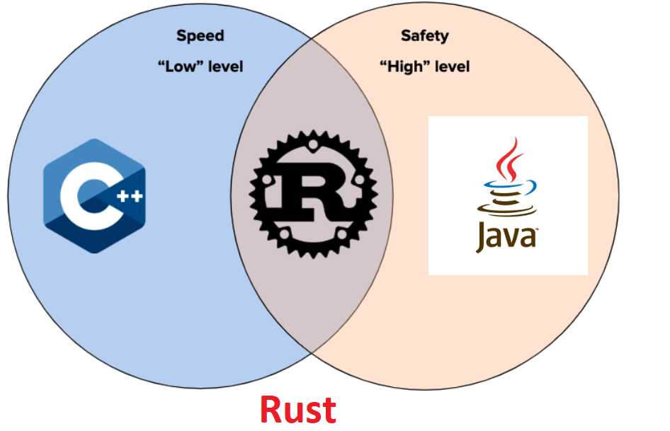
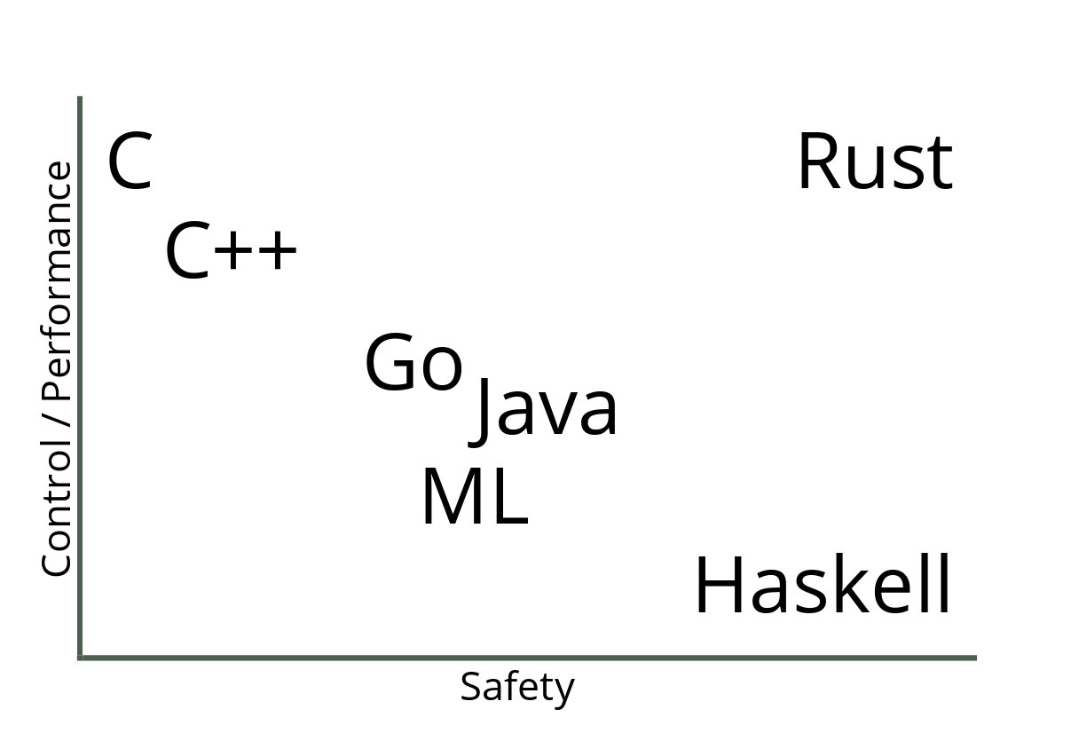
Rust offers safety, performance and low-level control

Slide 6
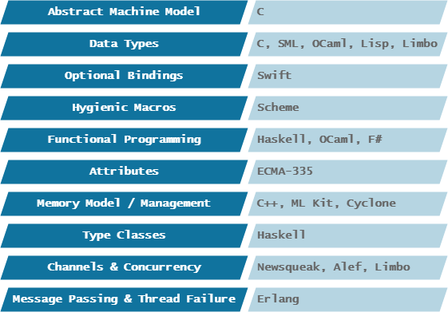
Rust has been influenced by many languages

Slide 7
Language Ranking
Rust
17th place (IEEE Spectrum)
26th place (TIOBE)

Slide 8
For what use cases is Rust suitable?
systems programming (main use case)
embedded development
High-Performance Computing (HPC) and scientific computing
web development
distributed peer-to-peer computing
game development
GUI development
machine learning
quantum computing
audio processing
…

Slide 9
What are some criticisms of Rust?
complex syntax
slow compilations
limited choice of compilers and target architectures compared to C
limited tooling
limited or immature third-party libraries
unsafe and difficult integrations with other languages
lack of a strict description of its semantics

Slide 10
Installation
Download Rust through rustup, a command line tool for managing Rust versions and associated tools.
Installing rustup on Linux or macOS
Open a terminal and enter the following command:
$ curl --proto '=https' --tlsv1.2 https://sh.rustup.rs -sSf | sh
Installing rustup on Windows
Go to https://www.rust-lang.org/tools/install and follow the instructions for installing Rust.

Slide 11
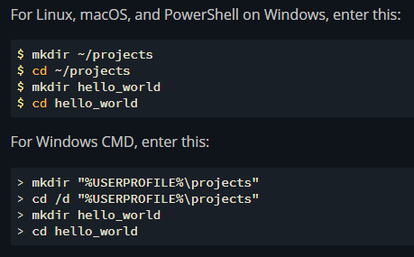
Hello, World! [1/2]
Creating a Project Directory

Slide 12
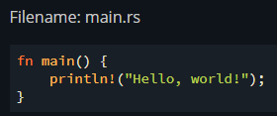
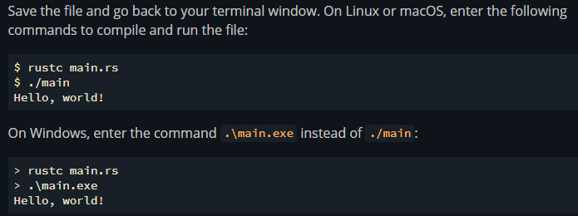
Hello, World! [2/2]
Writing and Running a Rust Program

Slide 13

Cargo [1/4]
Cargo is Rust’s build system and package manager.
build your code
download the libraries (dependencies) your code depends on
build those libraries
compile your packages
make distributable packages
upload packages to crates.io, the Rust community’s package registry

Slide 14

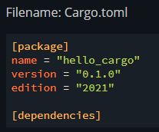
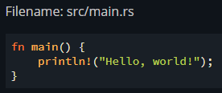
Cargo [2/4]
Creating a Project with Cargo

Slide 15
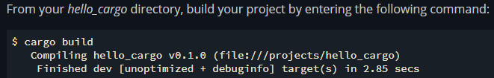
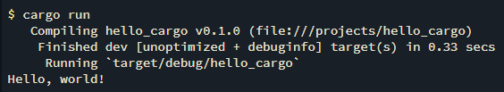
Cargo [3/4]
Building and Running a Cargo Project

Slide 16

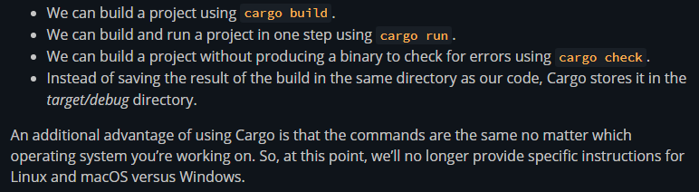
Cargo [4/4]

Slide 17
Rust’s features
Ownership
References and Borrowing
Lifetimes
Slices

Slide 18
Ownership: Rust’s most unique feature
Ownership is a set of rules that governs how a Rust program manages memory.
All programs have to manage the way they use a computer’s memory while running.
3 approaches:
some languages have garbage collection that constantly looks for no-longer used memory as the program runs
in other languages, the programmer must explicitly allocate and free the memory
Rust uses a third approach: memory is managed through a system of ownership with a set of rules that the compiler checks. If any of the rules are violated, the program won’t compile. None of the features of ownership will slow down your program while it’s running.

Slide 19
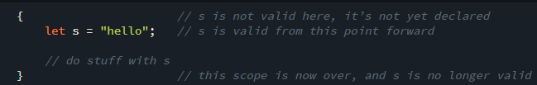
Ownership Rules
Each value in Rust has a variable that’s called its owner.
There can only be one owner at a time.
When the owner goes out of scope, the value will be dropped.

Slide 20
References and Borrowing
Reference
A reference is like a pointer in that it’s an address we can follow to access data stored at that address that is owned by some other variable.
Unlike a pointer, a reference is guaranteed to point to a valid value of a particular type.
Borrowing
The action of creating a reference.
As in real life, if a person owns something, you can borrow it from them. When you’re done, you have to give it back. You don’t own it.

Slide 21
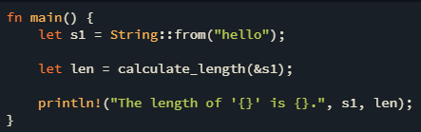

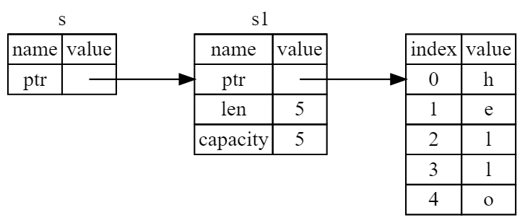
References and Borrowing
When functions have references as parameters instead of the actual values, we won’t need to return the values in order to give back ownership, because we never had ownership.

Slide 22
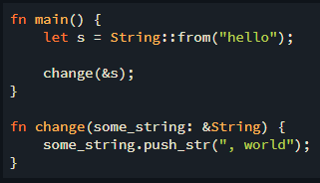
What happens if we try to modify something we’re borrowing?
Just as variables are immutable by default, so are references. We’re not allowed to modify something we have a reference to.
error: cannot borrow `*some_string` as mutable, as it is behind a `&` reference
------- help: consider changing this to be a mutable reference: `&mut String`
some_string.push_str(", world");
`some_string` is a `&` reference, so the data it refers to cannot be borrowed as mutable

Slide 23
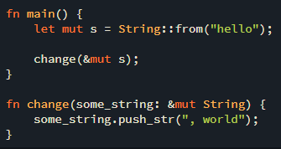
Mutable References
Mutable references have one big restriction: you can have only one mutable reference to a particular piece of data at a time.

Slide 24
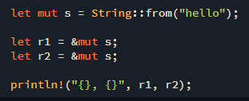
Two Mutable References
error: cannot borrow `s` as mutable more than once at a time
let r1 = &mut s;
------ first mutable borrow occurs here
let r2 = &mut s;
^^^^^^ second mutable borrow occurs here

Slide 25
Rust can prevent data races at compile time
Most languages let you mutate whenever you’d like.
The benefit of having the restriction of preventing multiple mutable references to the same data at the same time is that Rust can prevent data races at compile time.
Data races cause undefined behavior and can be difficult to diagnose and fix when you’re trying to track them down at runtime.
Rust prevents this problem by refusing to compile code with data races!

Slide 26
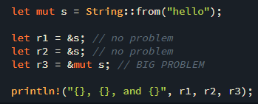
Combining mutable and immutable references
error: cannot borrow `s` as mutable because it is also borrowed as immutable
let r1 = &s; // no problem
-- immutable borrow occurs here
let r2 = &s; // no problem
let r3 = &mut s; // BIG PROBLEM
^^^^^^ mutable borrow occurs here

Slide 27
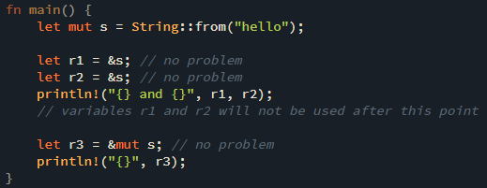
Non-Lexical Lifetimes
The scopes of the immutable references r1 and r2 end after the println! where they are last used, which is before the mutable reference r3 is created. These scopes don’t overlap, so this code is allowed.
The ability of the compiler to tell that a reference is no longer being used at a point before the end of the scope is called Non-Lexical Lifetimes.

Slide 28
Dangling References
In languages with pointers, it’s easy to erroneously create a dangling pointer--a pointer that references a location in memory that may have been given to someone else--by freeing some memory while preserving a pointer to that memory.
In Rust, by contrast, the compiler guarantees that references will never be dangling references: if you have a reference to some data, the compiler will ensure that the data will not go out of scope before the reference to the data does.

Slide 29
The Rules of References
At any given time, you can have either one mutable reference or any number of immutable references.
References must always be valid.

Slide 30
Lifetimes
Lifetimes allow us to borrow values in many situations while still enabling the compiler to check that the references are valid.
Every reference in Rust has a lifetime, which is the scope for which that reference is valid.
Most of the time, lifetimes are implicit and inferred.
We must annotate lifetimes when the lifetimes of references could be related in a few different ways. Rust requires us to annotate the relationships to ensure the actual references used at runtime will definitely be valid.
This analysis happens at compile time, which doesn’t affect runtime performance!

Slide 31
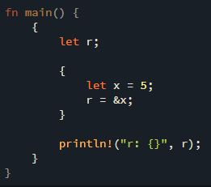
Preventing Dangling References with Lifetimes
The main aim of lifetimes is to prevent dangling references, which cause a program to reference data other than the data it’s intended to reference.
error: `x` does not live long enough
r = &x;
^^ borrowed value does not live long enough
}
- `x` dropped here while still borrowed
println!("r: {}", r);
- borrow later used here

Slide 32
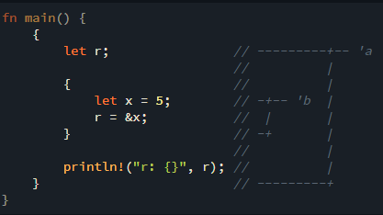
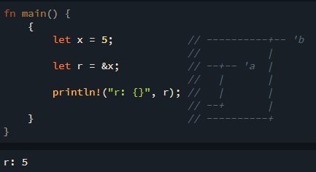
The Borrow Checker
The Rust compiler has a borrow checker that compares scopes to determine whether all borrows are valid.
Here, we’ve annotated the lifetime of r with 'a and the lifetime of x with 'b.
error: `x` does not live long enough

Slide 33
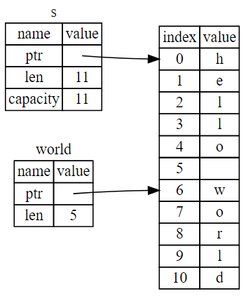
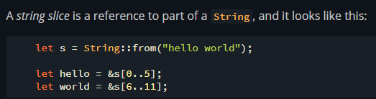
Slices
Slices let you reference a contiguous sequence of elements in a collection rather than the whole collection. A slice is a kind of reference, so it does not have ownership.
String Slices

Slide 34
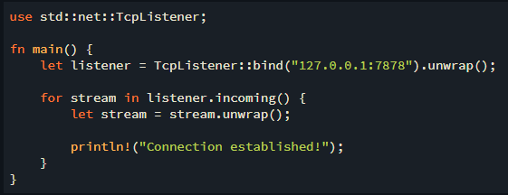
Building a Single-Threaded Web Server
Listening to the TCP Connection
Using TcpListener, we can listen for TCP connections at the address 127.0.0.1:7878.
The bind function will return a new TcpListener instance.
We use unwrap to stop the program if errors happen.
The incoming method on TcpListener returns an iterator that gives us a sequence of streams.

Slide 35
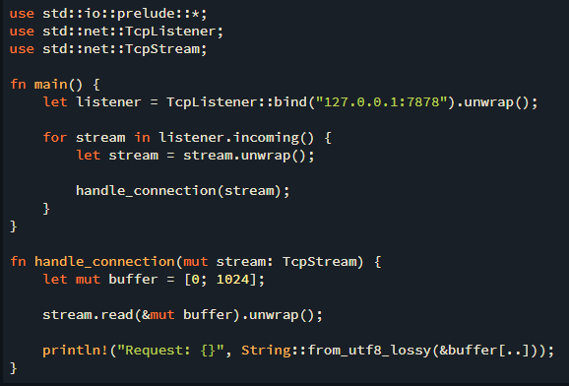
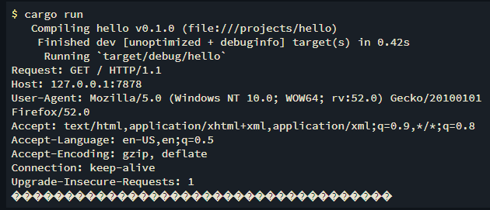
Reading the Request
In handle_connection function we’ll read data from the TCP stream.
We declare a buffer on the stack to hold the data that is read in. We pass the buffer to stream.read, which will read bytes from the TcpStream and put them in the buffer.
We convert the bytes in the buffer to a string and print that string.

Slide 36
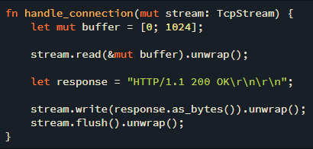
Writing a Response
response variable holds the success message’s data
as_bytes converts the string data to bytes
write method on stream sends those bytes directly down the connection
flush will wait and prevent the program from continuing until all the bytes are written to the connection

Slide 37
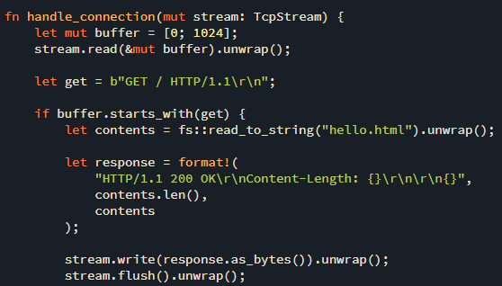
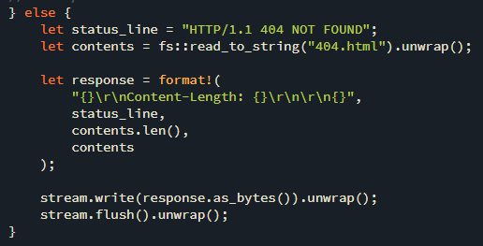
Validating the Request and Selectively Responding
Because we’re reading raw bytes into the buffer, we transform get into a byte string by adding the b"" byte string syntax at the start of the content data.
Then we check whether buffer starts with the bytes in get.
We use format! to add the file’s contents as the body of the response.
A simple web server in approximately 40 lines of Rust code.

Slide 38
Building a Multithreaded Web Server
A thread pool is a group of spawned threads that are waiting and ready to handle a task. When the program receives a new task, it assigns one of the threads in the pool to the task, and that thread will process the task.
A thread pool allows you to process connections concurrently, increasing the throughput of your server.

Slide 39
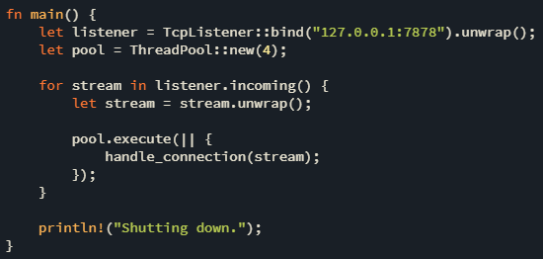
Building a Multithreaded Web Server
We use ThreadPool::new to create a new thread pool with a configurable number of threads.
pool.execute takes a closure and gives it to a thread in the pool to run.
Rust’s closures are anonymous functions you can save in a variable or pass as arguments to other functions (influenced by functional programming).

Slide 40
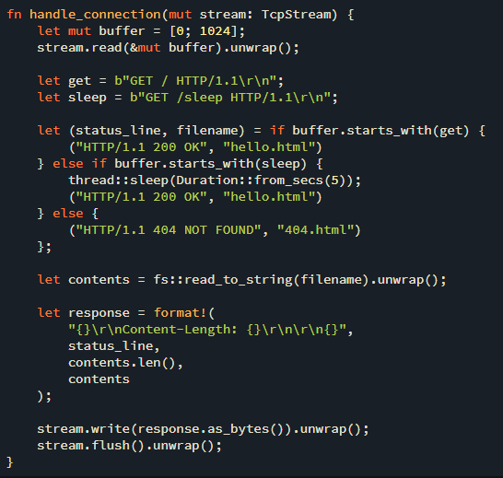
Building a Multithreaded Web Server

Slide 41
Summary [1/2]
Rust is a systems programming language focused on safety, speed and concurrency.
The concepts of ownership, borrowing, and slices ensure memory safety in Rust programs at compile time.
Rust is hard to learn.
Having the owner of data automatically clean up that data when the owner goes out of scope means you don’t have to write and debug extra code to get this control.

Slide 42
Summary [2/2]
Most programmers use Cargo to manage their Rust projects.
Rust can prevent data races at compile time.
Rust compiler guarantees that references will never be dangling references.
At any given time, you can have either one mutable reference or any number of immutable references.

Slide 43
References
https://www.tiobe.com/tiobe-index/
https://spectrum.ieee.org/top-programming-languages/
https://www.rust-lang.org/
https://en.wikipedia.org/wiki/Rust_(programming_language)
https://devopedia.org/rust-language
https://doc.rust-lang.org/rust-by-example/index.html

Slide 44
THANK YOU FOR YOUR ATTENTION!

